Slide 1
Music genre classification
Nguyễn Lê Thanh Hà – BI9-094
Nguyễn Quốc Thông – BI9-214
Vũ Vương Quốc Anh – BI9-046
Phí Đỗ Hải Long – BI9-149
Ngô Xuân Minh – BI9-167
Notes:
Automatically classify different musical genres

Slide 2
Outline
Overview & Objective
Contribution
Dataset
Feature Extraction
Classifier Methods
Comparision

Slide 3
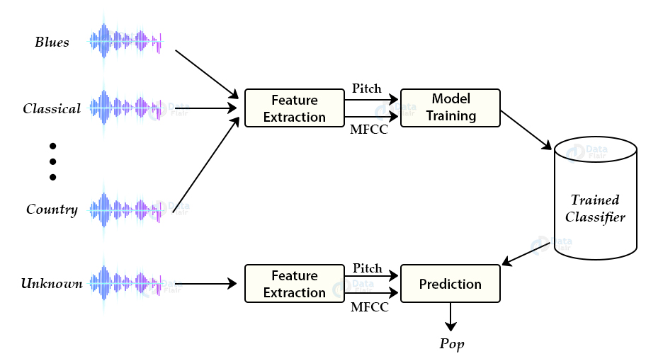
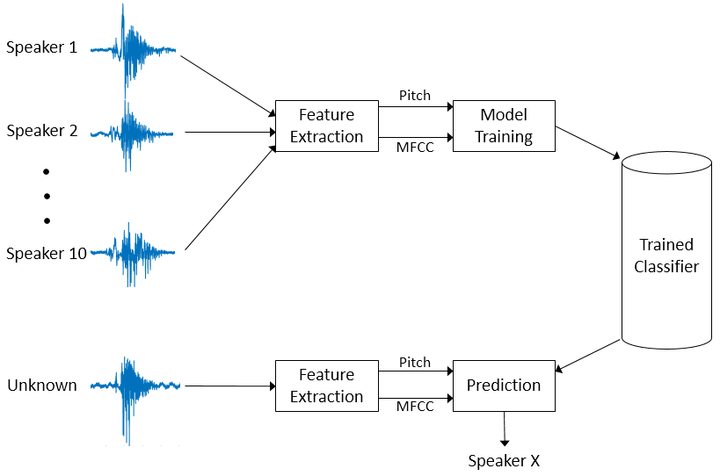
Overview & objective
Notes:
Overall flow of building the classifier.

Slide 4
contribution
Member | Contribution
Ngô Xuân Minh | Build model for Convolutional neural networks (CNN) classifier
Vũ Vương Quốc Anh | Build model for Multiclass support vector machines (MCSVM) classifier
Phí Đỗ Hải Long | Build model for K-nearest neighbors (KNN) classifier
Nguyễn Quốc Thông | Build model for K-means clustering (Kmeans) classifier
Nguyễn Lê Thanh Hà | Summarize algorithms theory, make slides and present

Slide 5

dataset
The GTZAN genre collection dataset:
- 1000 audio – 10 genres
- 30 seconds duration
Notes:
consists of 1000 audio files. There are 10 classes ( 10 music genres) each containing 100 audio tracks. each audio file having 30 seconds duration

Slide 6
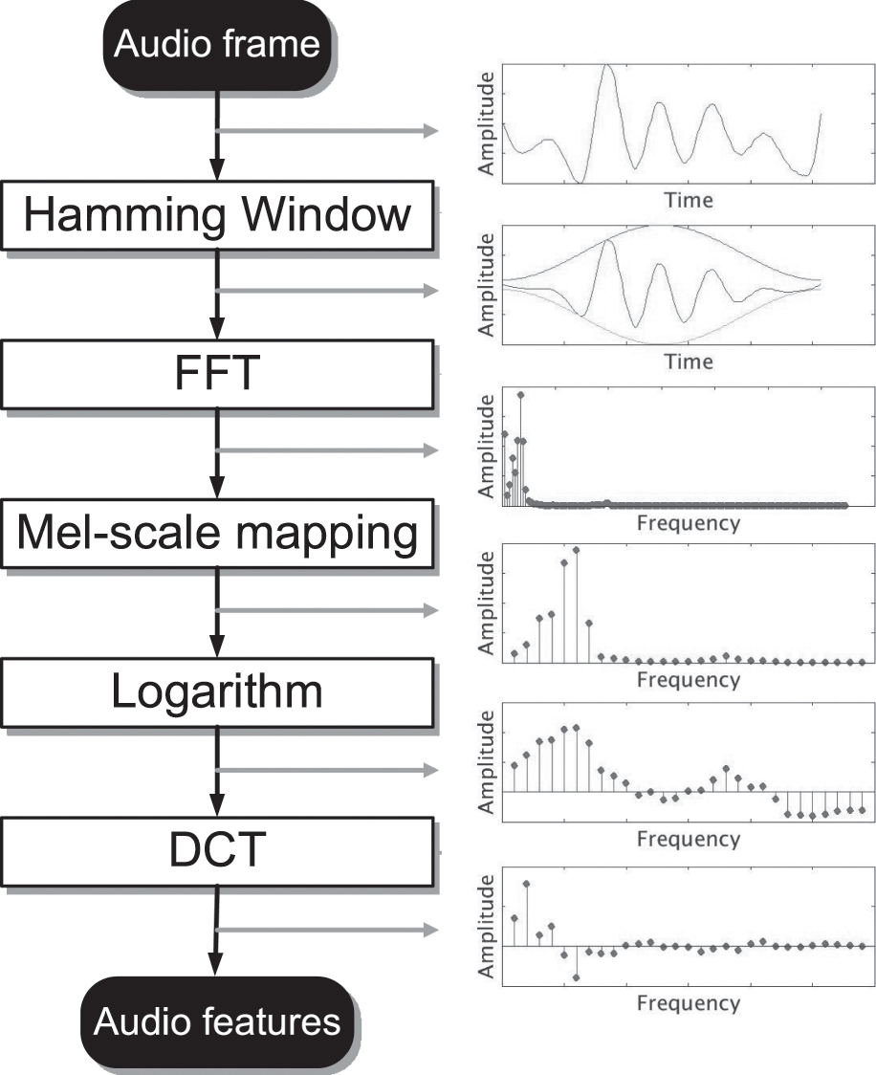
Feature Extraction Mel Frequency Cepstral Coefficients
1. Divide these signals into small frames
2. Identify different frequencies present in each frame
3. Separate linguistic frequencies from the noise
Notes:
The first step for music genre classification project would be to extract features and components from the audio file.
Since the audio signals are constantly changing, first we divide these signals into smaller frames. Each frame is around 20-40 ms long.
To identifying which frequencies are present in the frame, periodogram estimation is performed
To discard the noise, it then process 3 steps:
Mel filterbank: to get an idea of how much energy exists in various frequency regions
take the logarithm of them: compress the frequency
discrete cosine transform (DCT) :keep only a specific sequence of frequencies that have a high probability of information.

Slide 7
Music Genre Classification approach
1. K-means clustering
2. Multiclass support vector machines
3. K-nearest neighbors
4. Convolutional neural networks

Slide 8
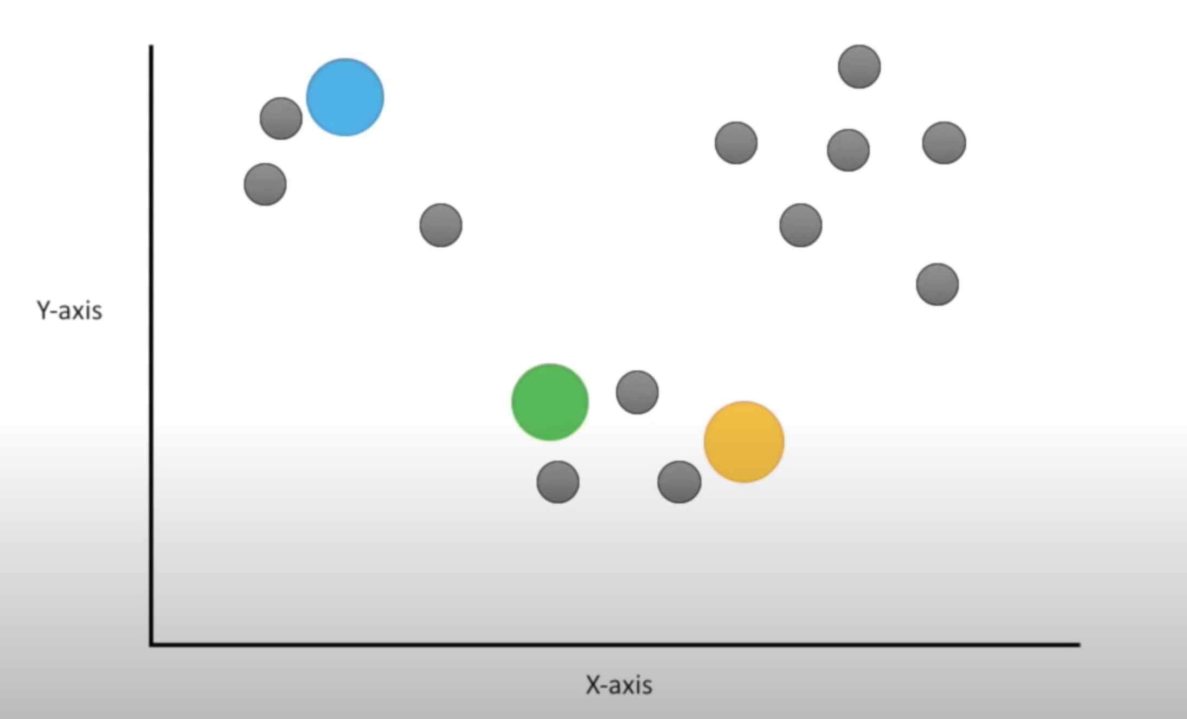
1. K-means clustering
Notes:
KMeans is a clustering algorithm which divides observations into k clusters. In this example, we will divide the datasets into 3 clusters, the algorithm starts with 3 random starting points as initial centroids

Slide 9
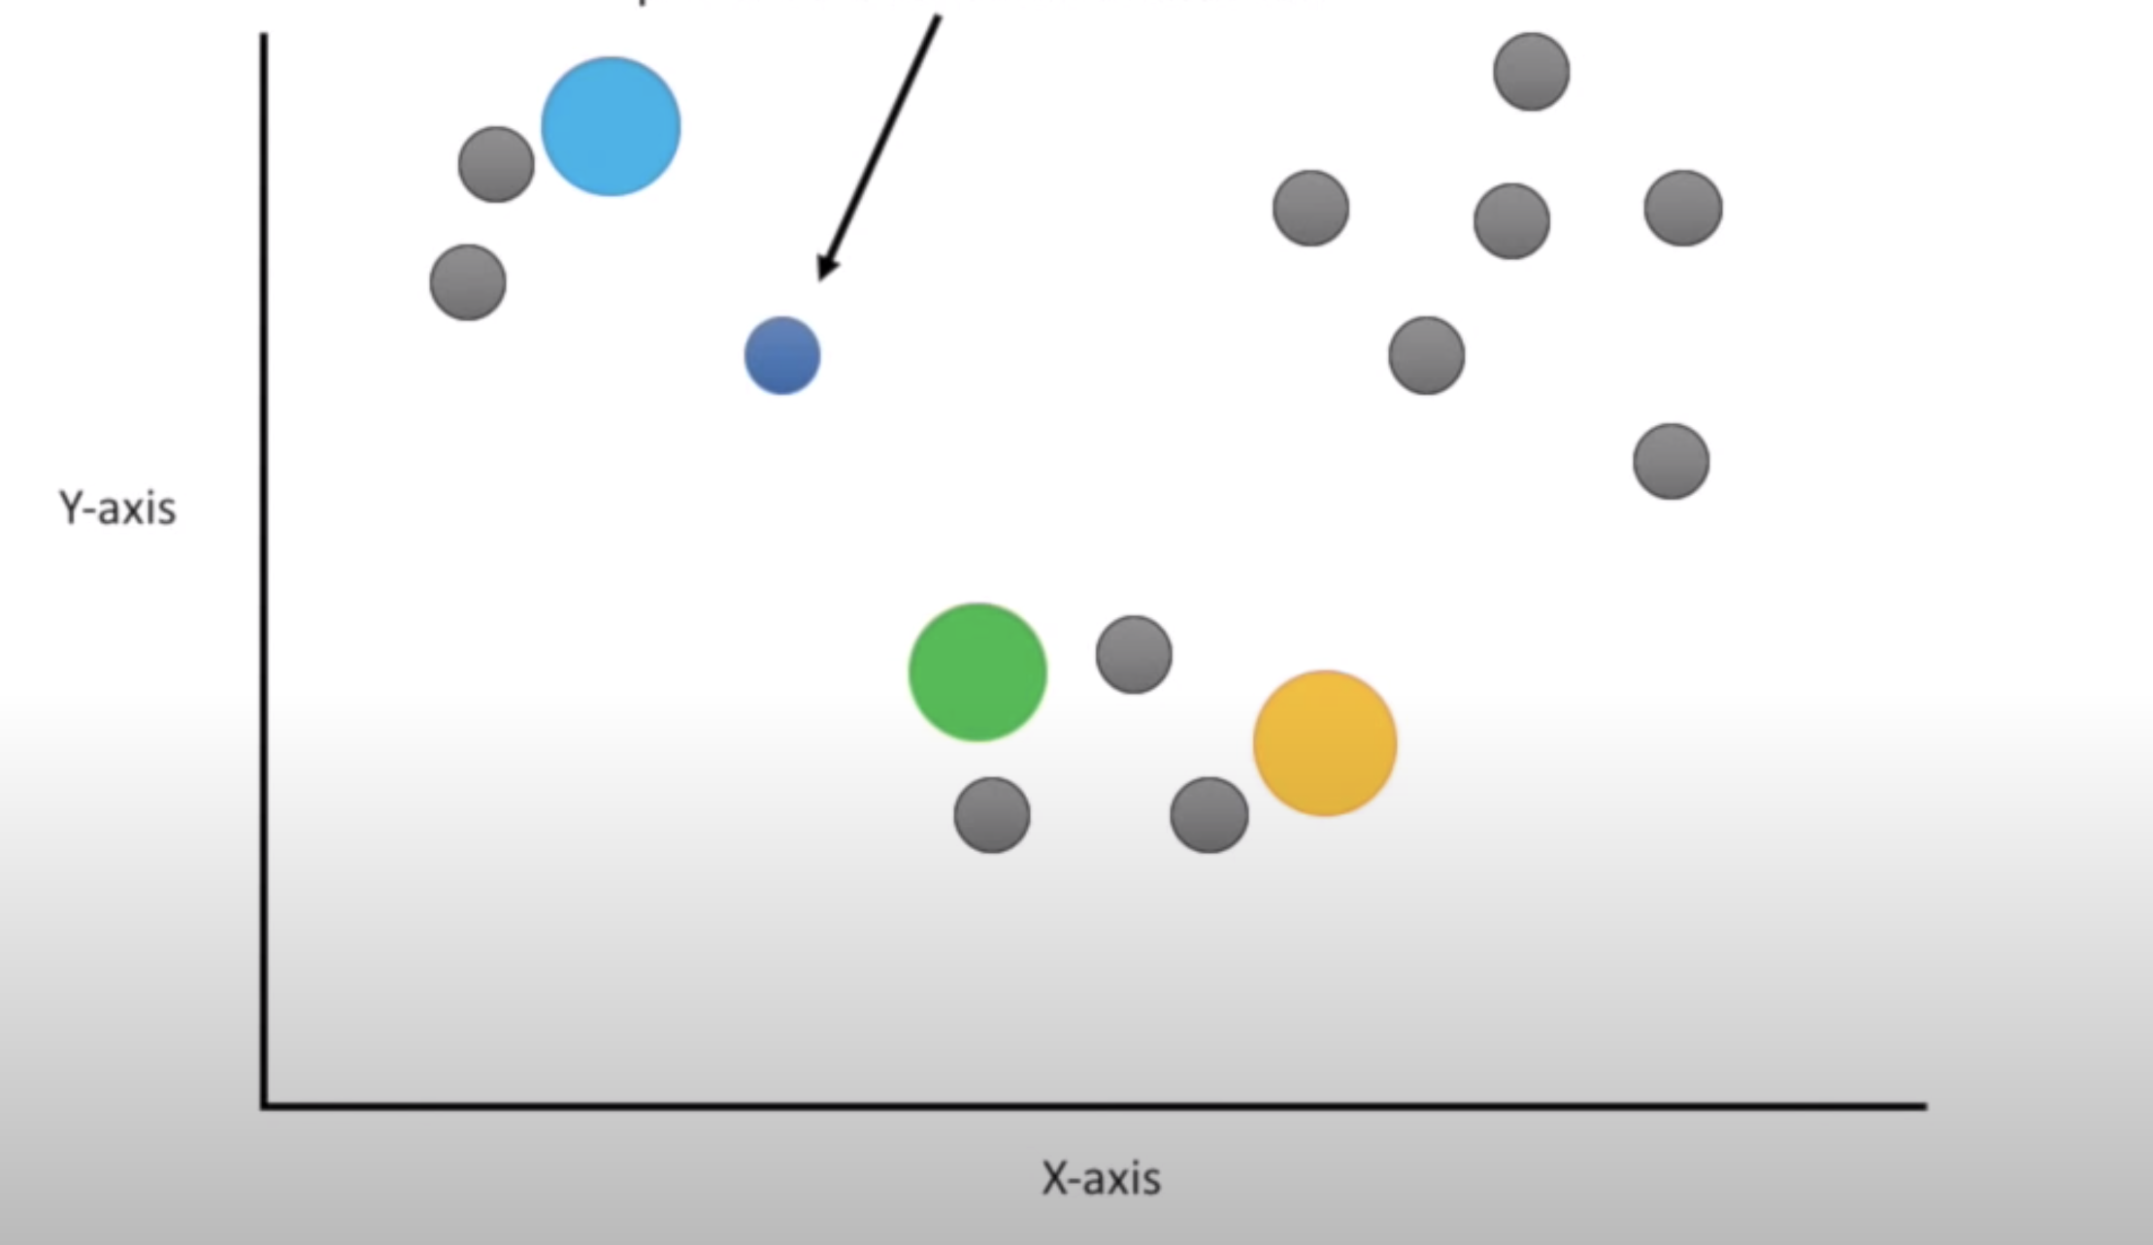
1. K-means clustering
Notes:
And we apply the Euclidean distance to others points and find the shortest path from starting points to each undefined point here. For specific, this point is closest to the blue

Slide 10
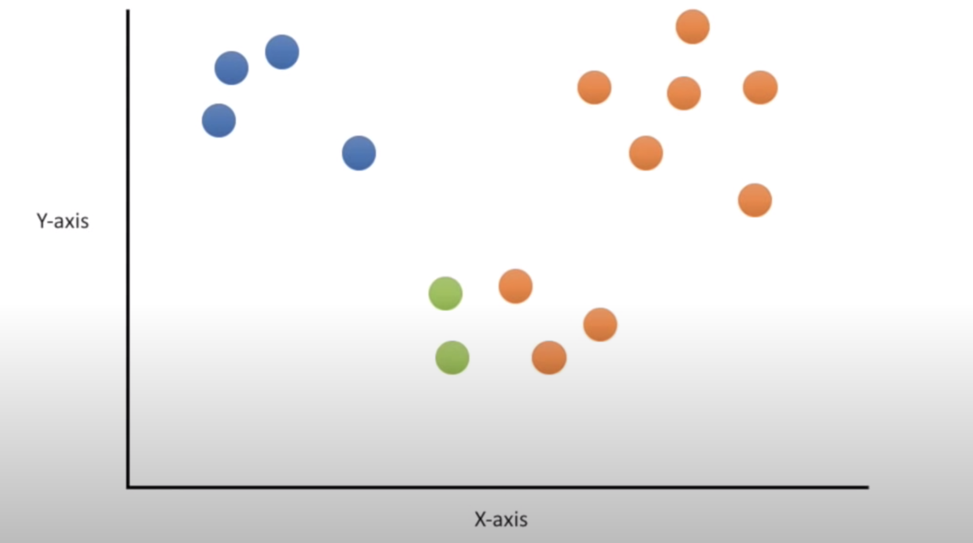
1. K-means clustering
Notes:
Doing similar to all gray point, we assign each of them to the nearest cluster

Slide 11
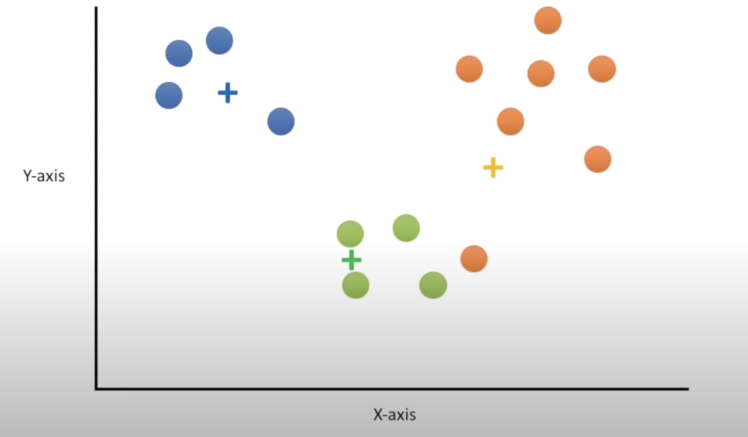
1. K-means clustering
Notes:
Next, we calculate the center of each cluster and recluster

Slide 12
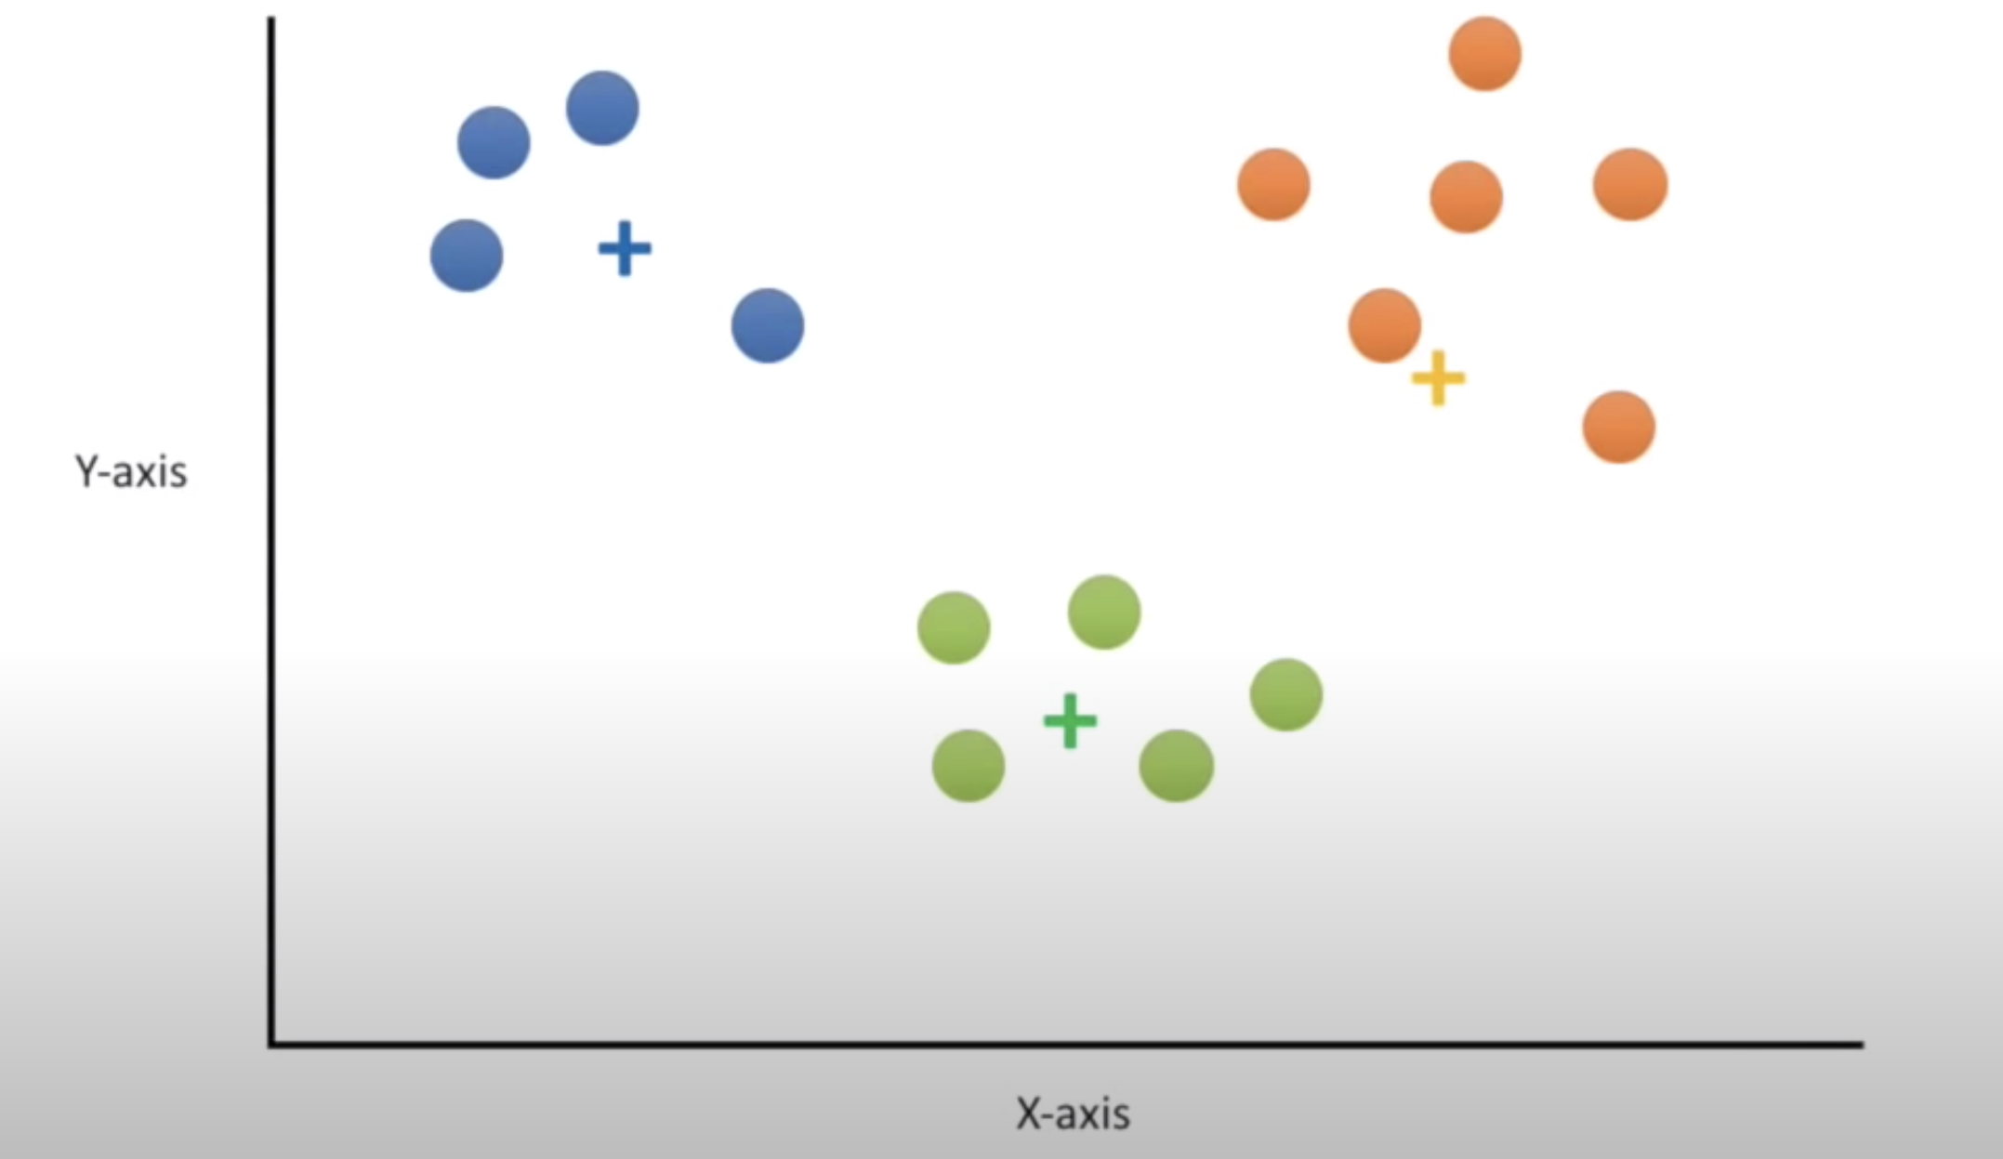
1. K-means clustering
Notes:
Next, we calculate the center of each cluster and recluster

Slide 13
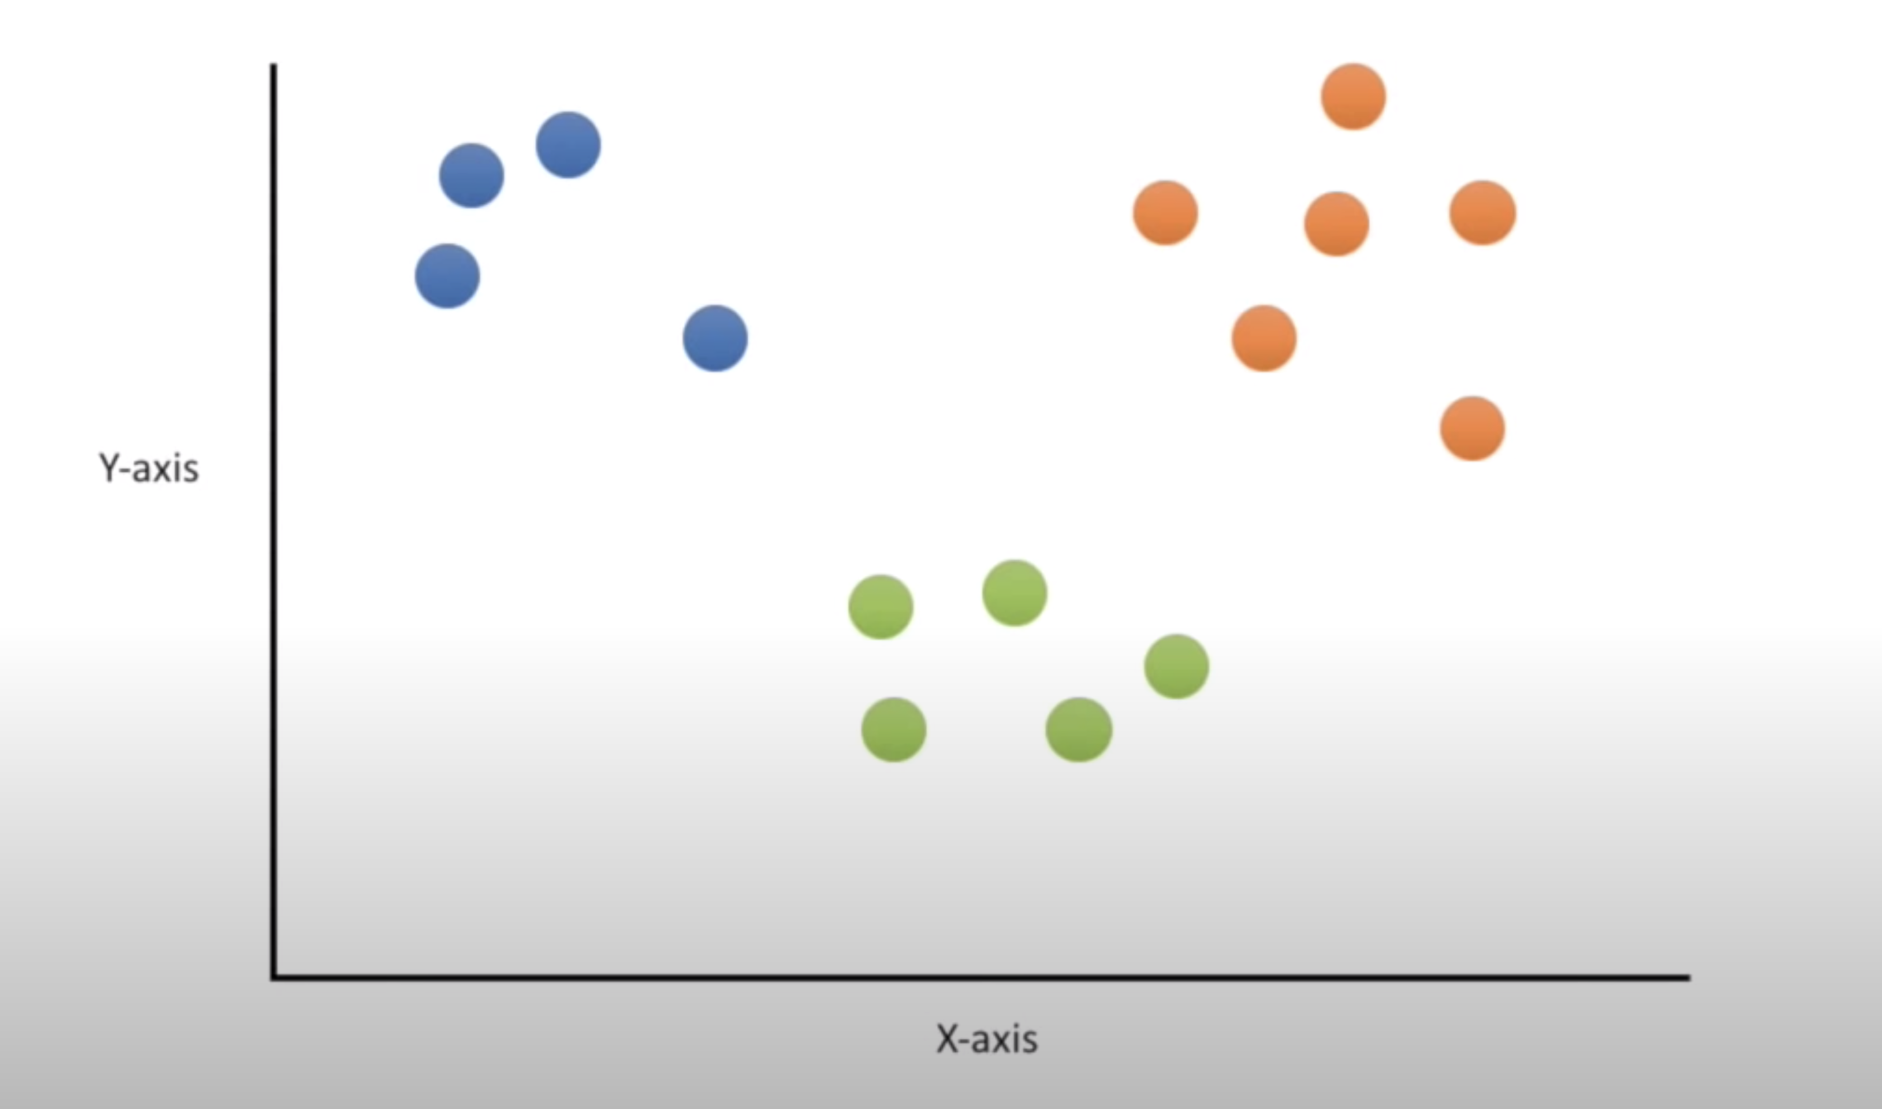
1. K-means clustering
Notes:
Now we have 3 beautiful cluster

Slide 14
1. K-means clustering
Notes:
With the classification problem, we have an unknown cluster data point. The k means algorithm will assign that point to the nearest cluster doing similar steps as above

Slide 15
1. K-means clustering
Notes:
In this example, the test point will be assigned to blue cluster

Slide 16
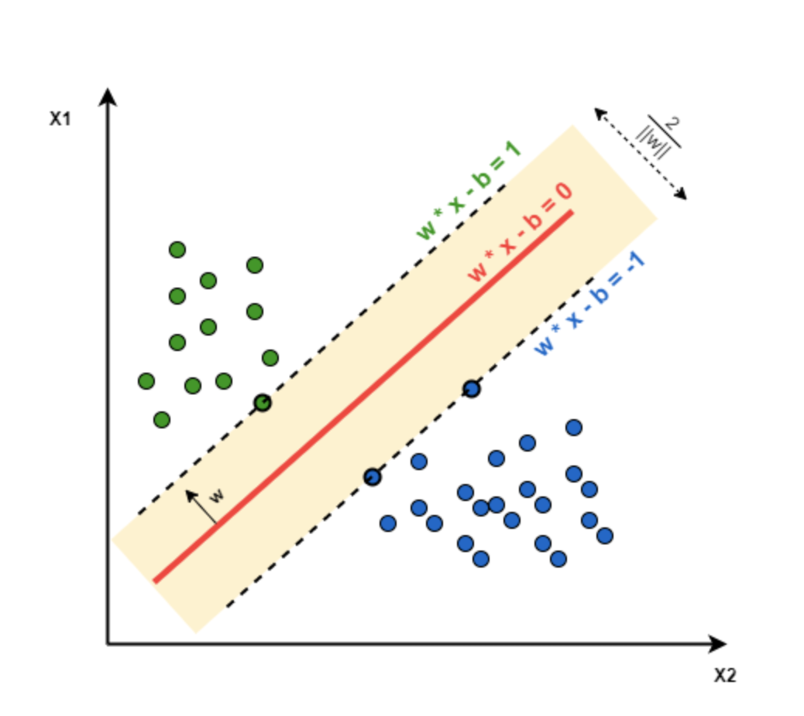
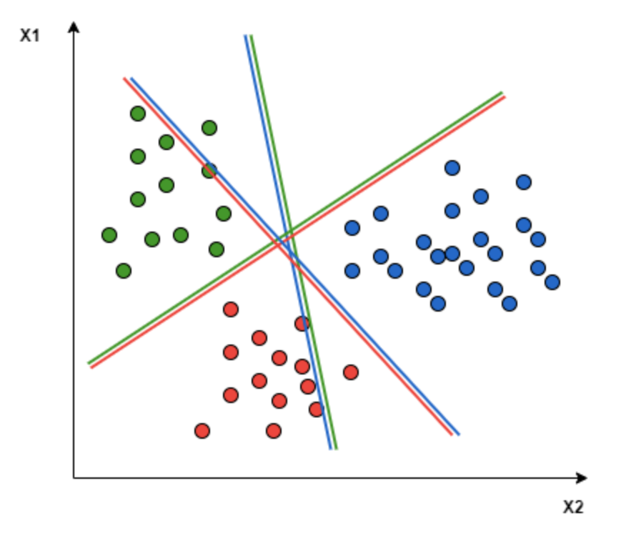
2. Multiclass support vector machines
Singleclass
Multiclass
Notes:
Basically, SVM tries to find a hyperplane that maximizes the separation between dataset’s classes.
- In singleclass problem, the hyperplane is this red line, which is also call decision boundary that anything falls to the left side of it we will classify as green, and anything that falls to the right as blue.
- Extend the problem to multiclass: in this project we use svm model pre-build by sklearn, which is using one-to-one approach, which breaks down the multiclass problem into multiple binary classification problems. A binary classifier per each pair of classes. In the One-to-One approach, we need a hyperplane to separate between every two classes, neglecting the points of the third class. This means the separation takes into account only the points of the two classes in the current split. For example, the red-blue line tries to maximize the separation only between blue and red points. It has nothing to do with green points:

Slide 17
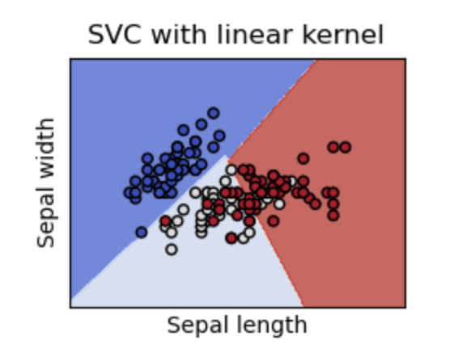
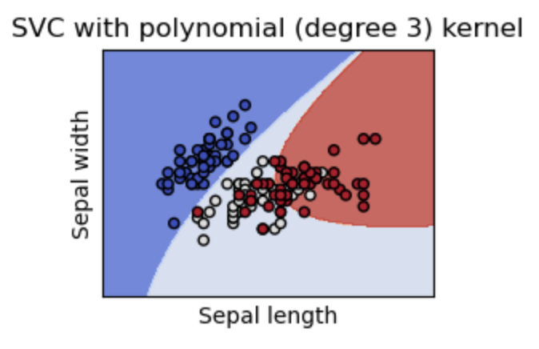
2. Multiclass support vector machines
Notes:
The hyperplane shape is decided by the function kernel. in example above it is all based on linear kernel, however, in our project we use two different kernels: linear and polynomial

Slide 18
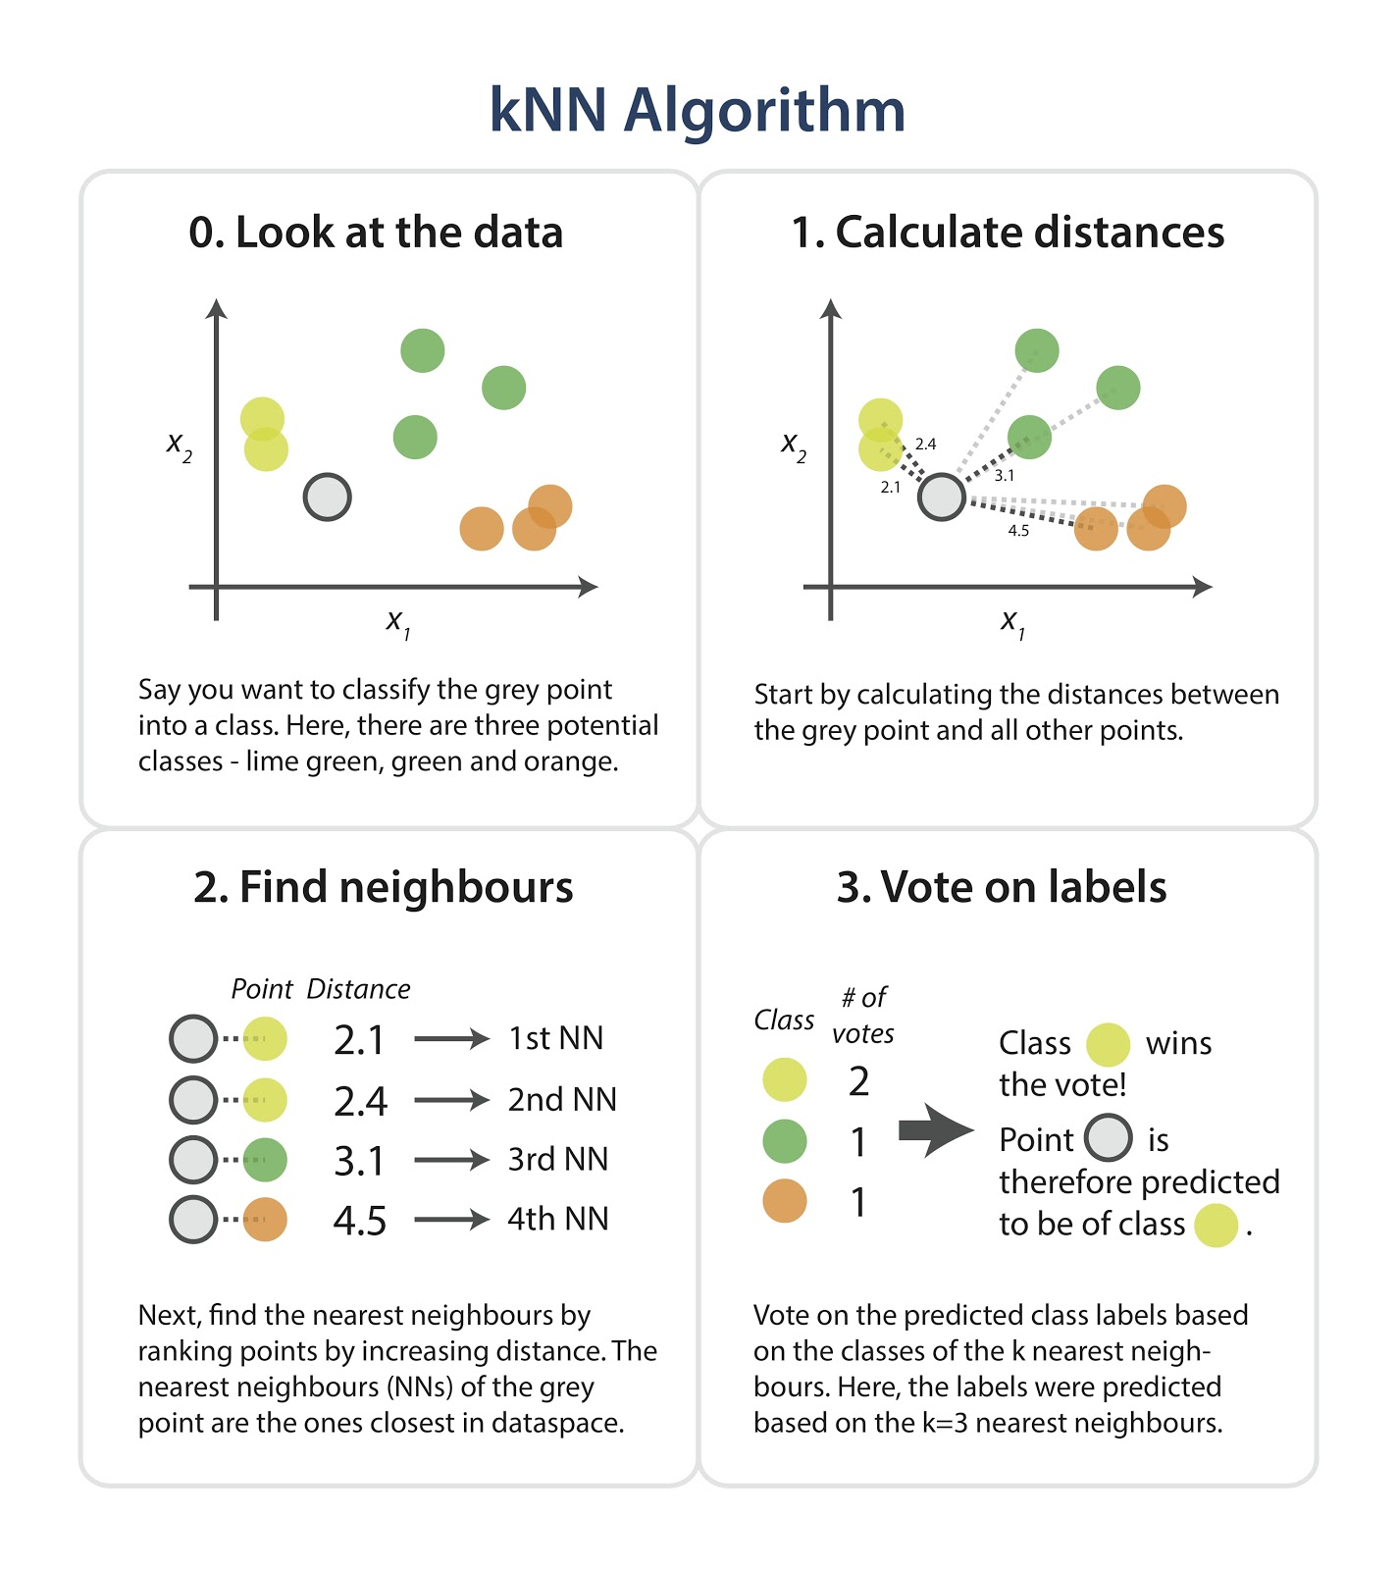
3. K-nearest neighbors
Notes:
0: We want to classify they gray point into a class. In this example, there are three potential classes: lime green, green and orange
1: knn algorithm start by calculating the distances between the grey point and all other points
2: next, the algorithm find the nearest neighbours by ranking points by increasing distance.
3: vote the class label based on which classes has the most neares neighbor, in this example it is lime green class

Slide 19
3. K-nearest neighbors
Notes:
0: We want to classify they gray point into a class. In this example, there are three potential classes: lime green, green and orange
1: knn algorithm start by calculating the distances between the grey point and all other points
2: next, the algorithm find the nearest neighbours by ranking points by increasing distance.
3: vote the class label based on which classes has the most neares neighbor, in this example it is lime green class

Slide 20
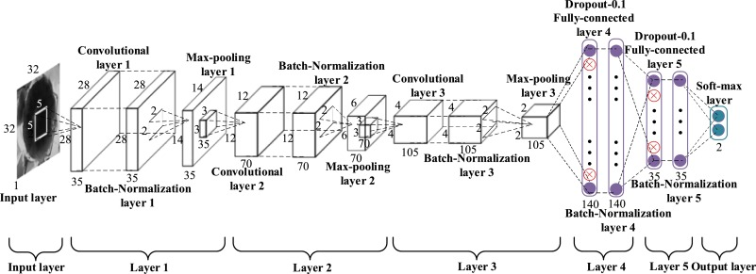
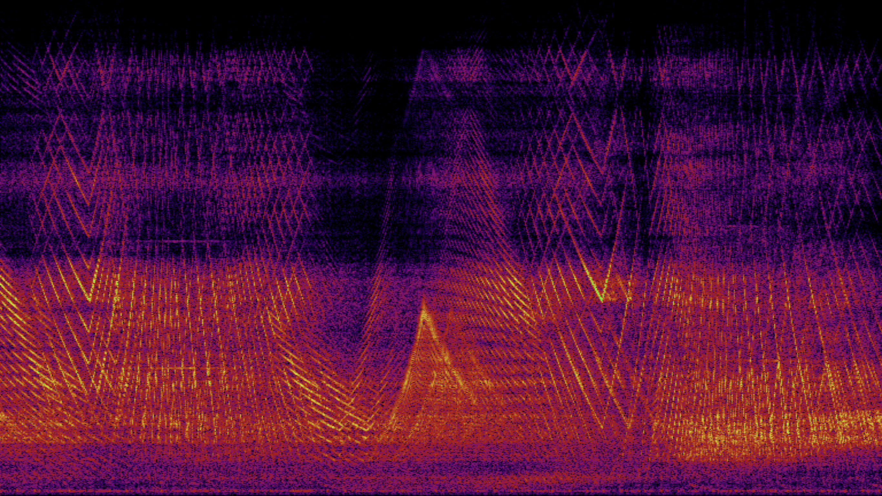
4. Convolutional neural networks
Notes:
Convolutional neural networks (CNNs) are made up of layers of neurons that have learnable weights and biases. Each neuron receives some inputs, performs a dot product and optionally follows it with a non-linearity.
Input layer as a spectrogram image
The model has 3 convolutional layer, in each convolutional layer there is convolutional layer, a maxpooling layer and a normalization layer
In the dense layer: there is Flatten layer and dropout layer
Output layer as feature of each music genre

Slide 21


4. Convolutional neural networks
Convolution Layer
Max Pooling Layer
Notes:
The convolutional layer is the core building block of a CNN, convolution is used to find the same feature in different places of an image. Convolution is conducted using learnable kernel passed through the input image.
Another important concept of CNNs is pooling, which is a form of non-linear down-sampling. The pooling layer serves to progressively reduce the spatial size of the representation, to reduce the number of parameters, extracts the sharpest features. Each subregion chose the max value as its representative value

Slide 22

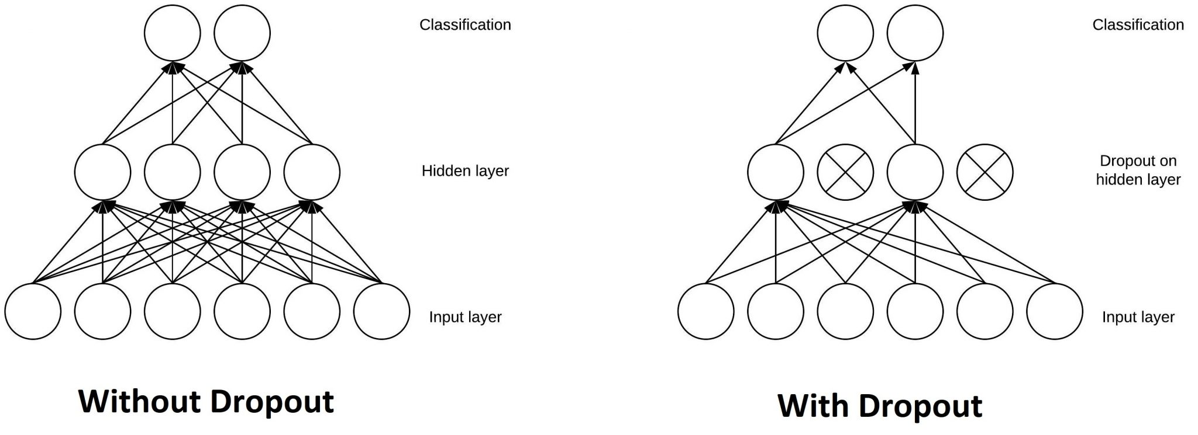
4. Convolutional neural networks
Flatten Layer
Dropout Layer
Notes:
Flatten layer (fully connected layer) convert from 2D to 1D layer
Because a fully connected layer occupies most of the parameters, it is prone to overfitting. One method to reduce overfitting is dropout. A dropout layer improve network robustness (network can rely too much on specific neuron). The dropout nodes is chossing randomly

Slide 23
comparision
Algorithm | Accuracy
K-Means | Inconsistent (29% - 39%)
MCSVM | Polynomial Kernel: 66.00% Linear Kernel: 69.50%
KNN | 67.34%
CNN | 72.03%

Slide 24
Thank you for listening

